Slide 1
Supermarket Customers Data Analysis
Capstone Project - Hendry Hansel Kurniawan Lessy

Slide 2
Background
Supermarkets compete to increase customer satisfaction and retain loyalty through personalized services and targeted marketing strategies. By analyzing customer purchasing data and responses to promotions, the company can gain insight into customer behavior patterns. This analysis aims to uncover key trends that will assist in designing more effective marketing strategies and improving customer experience.

Slide 3
Problem Statement
Main Question:
What is the biggest factor influencing customer spending in supermarkets, and how can the company enhance customer loyalty through more effective marketing strategies?
Sub-Question:
Are there spending patterns based on demographics, such as age, marital status, or number of children?
What is the average spending of customers on specific product categories (meat, wine, fish, etc.)?
Are customers who receive regular marketing campaigns more likely to make a purchase?

Slide 4
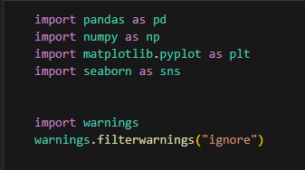
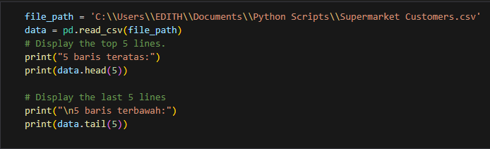
Data Understanding

Slide 5
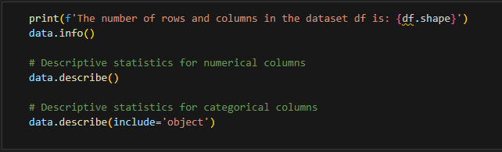
Data Understanding

Slide 6
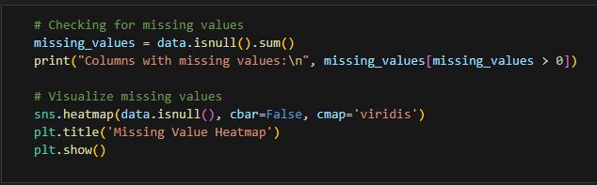
Missing value

Slide 7
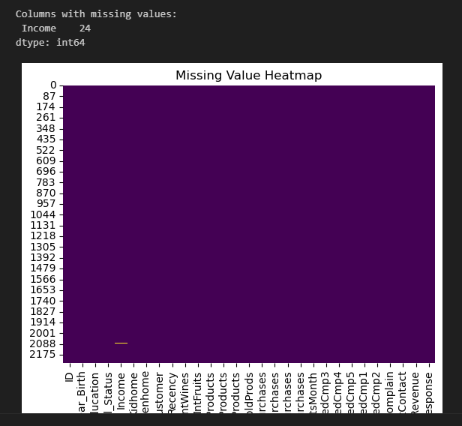
Missing Value

Slide 8
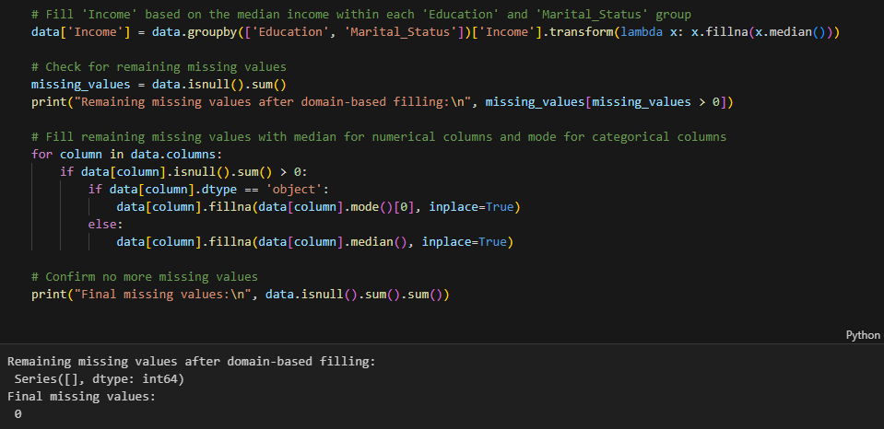
Handling Missing Value

Slide 9
Handling Missing Value

Slide 10
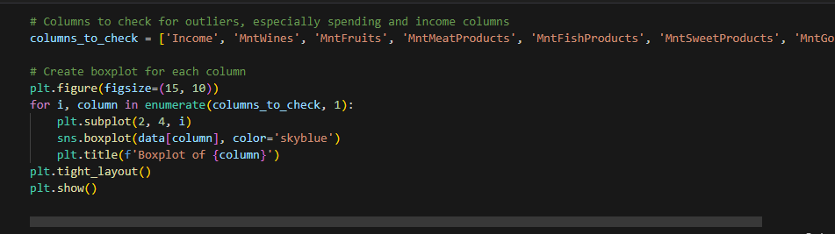
Outlier Control

Slide 11
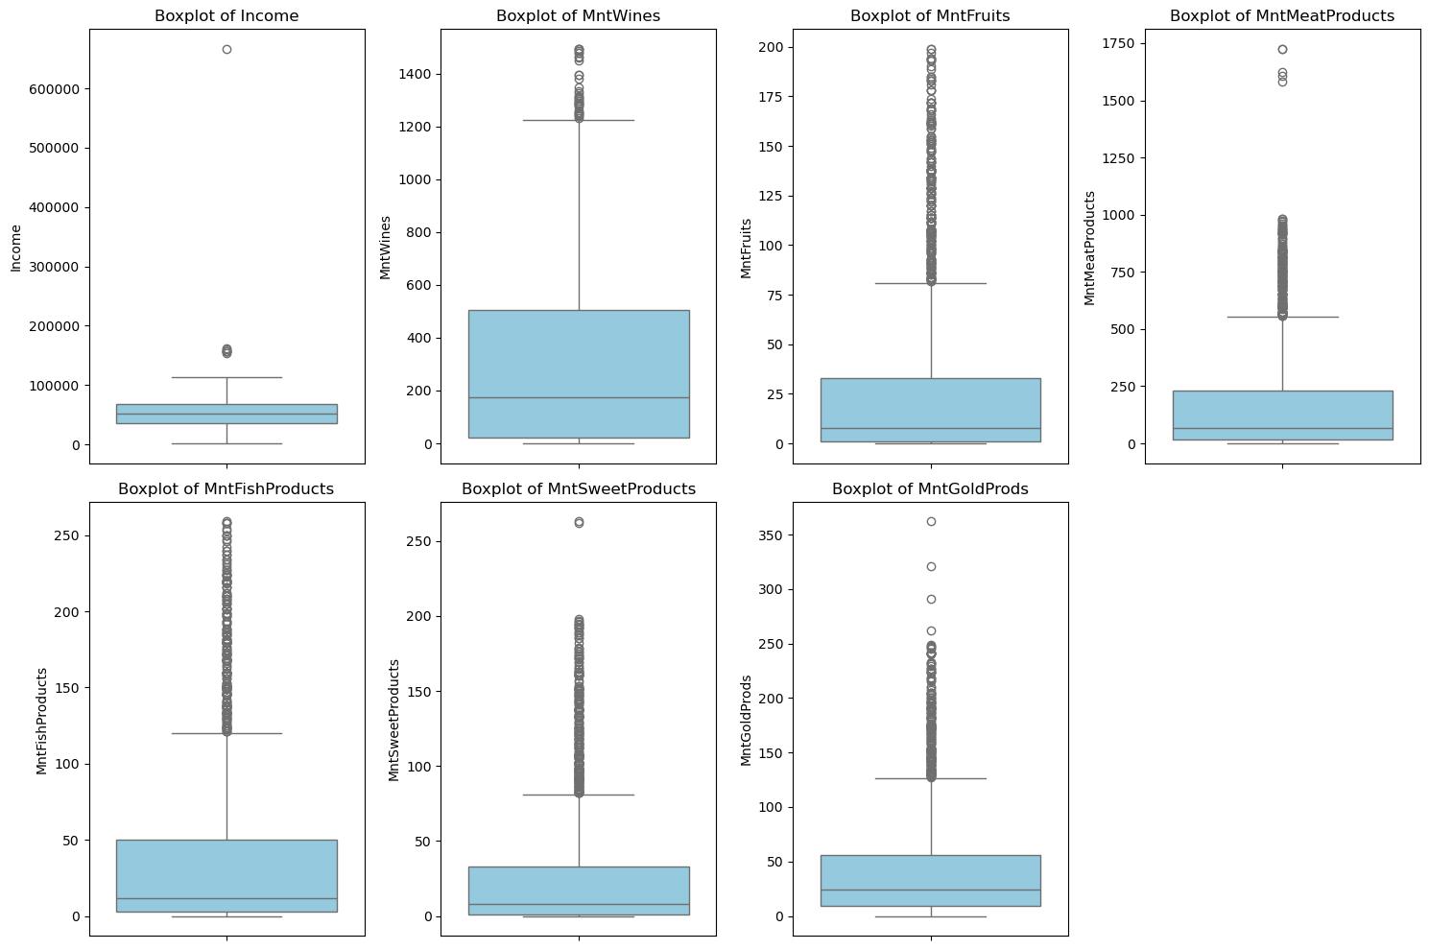
Outlier Control

Slide 12
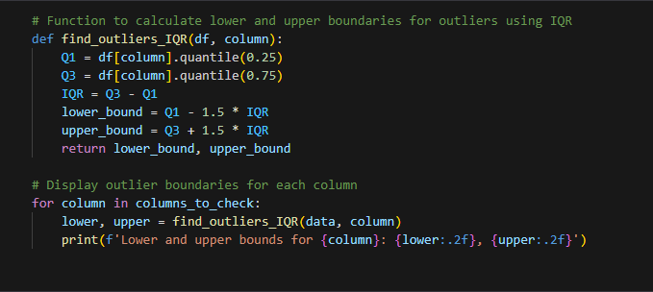
Outlier Control

Slide 13
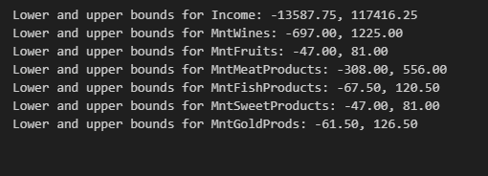
Outlier Control

Slide 14
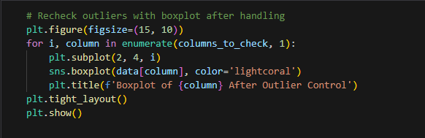
Checking Outlier Handling

Slide 15
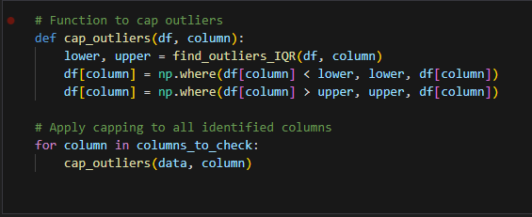
Outlier Control With Capping

Slide 16
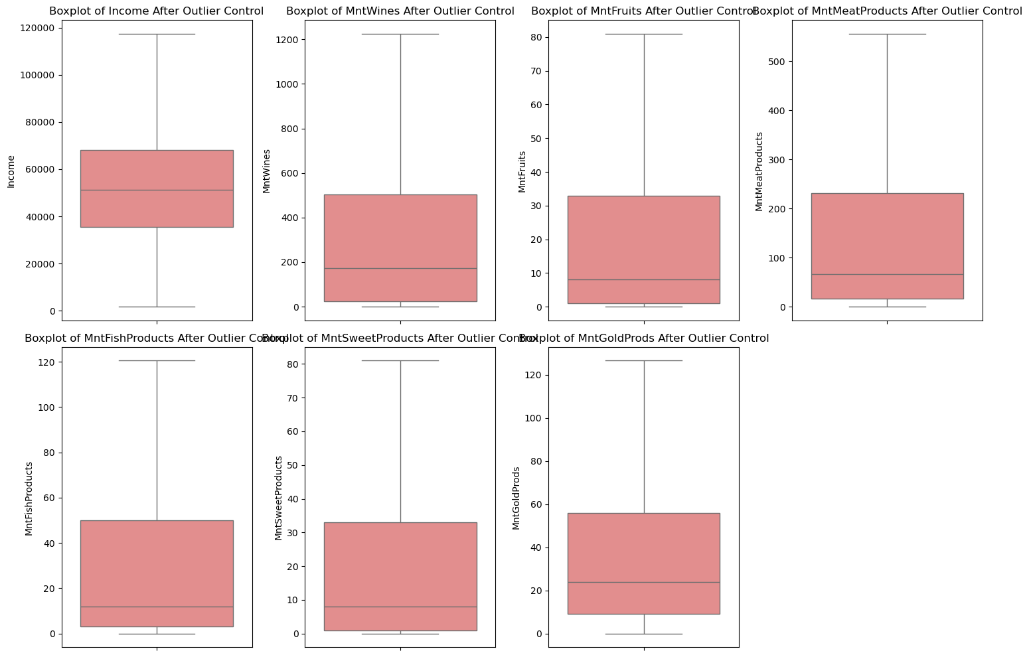
Outlier Control With Capping

Slide 17
Data Analysis

Slide 18
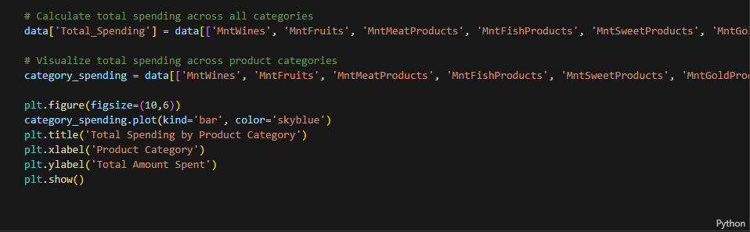
Total Spending by Product Category

Slide 19
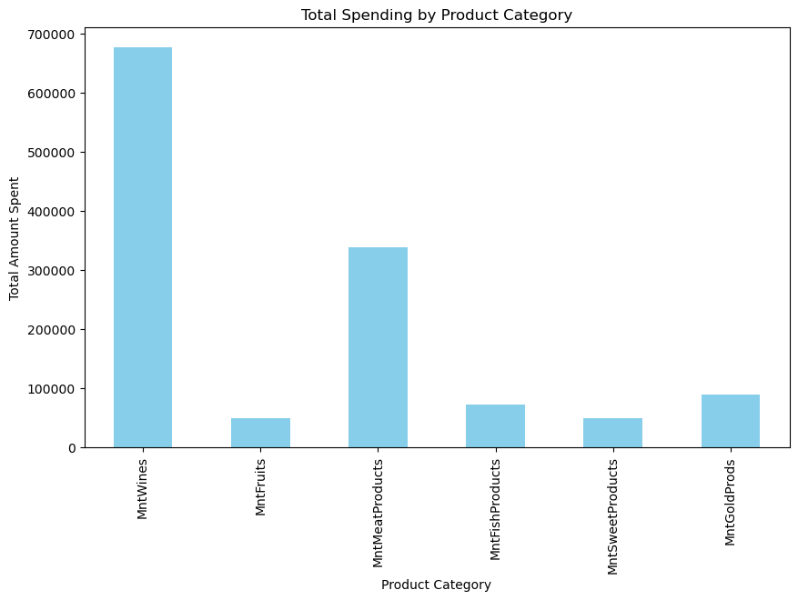
Total Spending by Product Category

Slide 20
Spending Analysis by Demographic Groups
Spending by Marital Status
Spending by Education Level

Slide 21
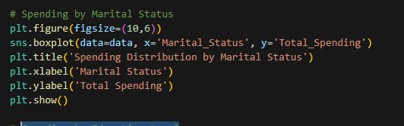
Spending by Marital Status

Slide 22
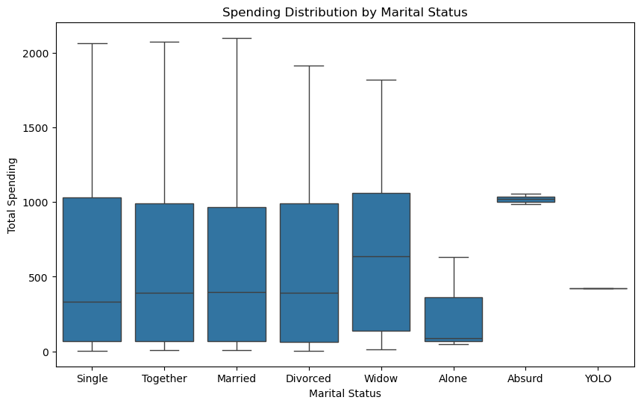
Spending by Marital Status

Slide 23
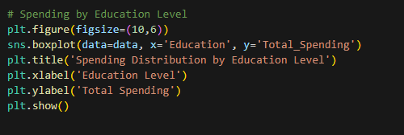
Spending by Education Level

Slide 24
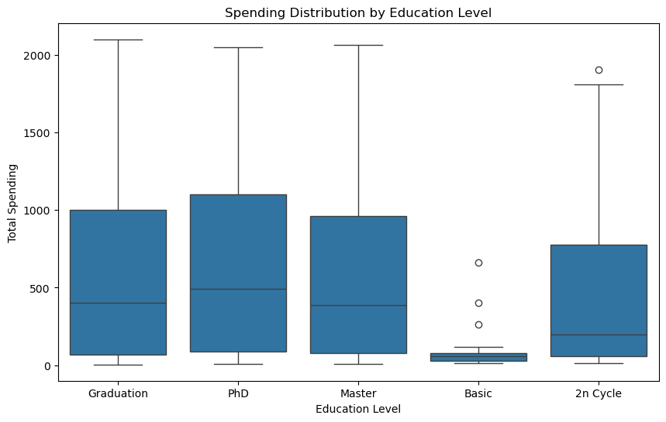
Spending by Education Level

Slide 25
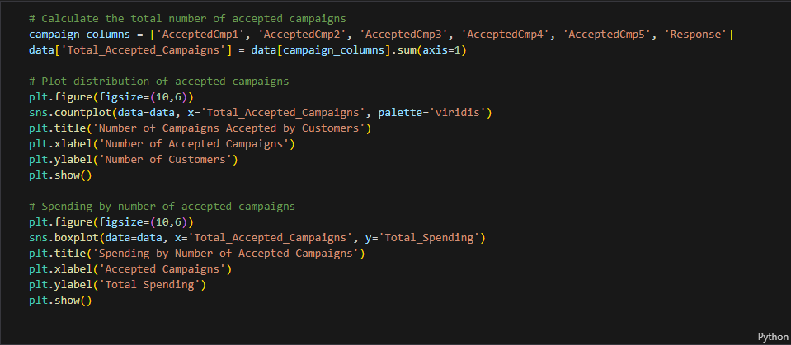
Customer Response to Marketing Campaigns

Slide 26
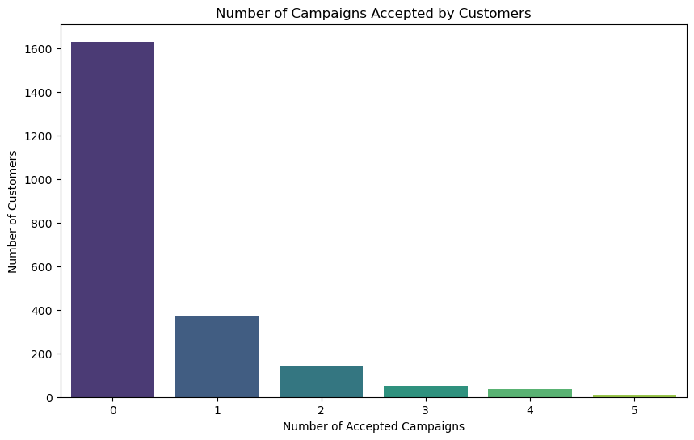
Customer Response to Marketing Campaigns

Slide 27
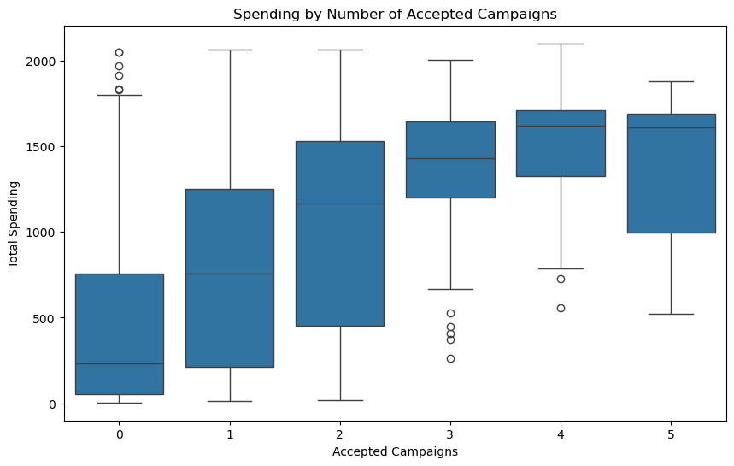
Customer Response to Marketing Campaigns

Slide 28
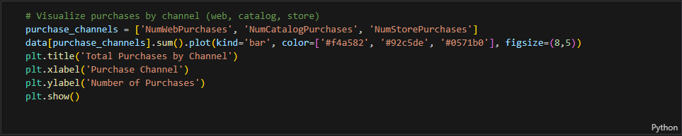
Purchase Channel Analysis

Slide 29
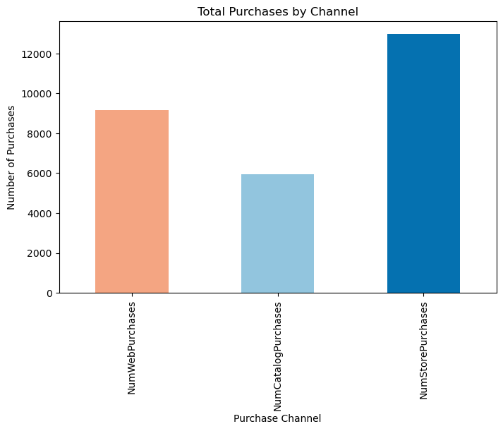
Purchase Channel Analysis

Slide 30
Conclusions
Wine have the highest spending, followed by Meat products. Targeted promotions on these categories may have the biggest impact.
Married customers tend to have higher spending, so family-oriented promotions may be effective.
Customers who accept marketing campaigns generally spend more, indicating the effectiveness of such campaigns.
-
Web purchases are lower than store purchases, suggesting room for growth in online sales.
The Sun is the star at the center of the Solar System

Slide 31
Recommendations
Increase promotions on high-spending categories like wine and meat products.
Maintain and optimize marketing campaigns to drive purchases.
Improve the online shopping experience to boost sales through web channels.
Focus targeting campaigns towards married and family-oriented customers.

Slide 32
Thanks!

